Slide 1

Self Driving Car
Group No. 15
Mahek Jain 17204010
Vinit Shah 17204014
Hiral Thadeshwar 17204012
Project Guide : Prof. Rujata Chaudhari
Co-guide : Prof. Vishal Badgujar

Slide 2
Contents
Abstract
Introduction
Objectives
Literature Review
Problem Definition
Existing System Architecture/Working
Proposed System Architecture/Working
Technology Stack
Scope of the Project
Project Limitations
Conclusion
References

Slide 3
Abstract
The basic idea behind the project is to develop an automated car that is capable of sensing its environment and moving without any human input.
The automation will be achieved by detecting lane marking, signals, obstacles, stop sign using image processing and neural network to react and take decisions such as changing the course of the car, stopping on stop signs and red signal, and moving on green signal.

Slide 4
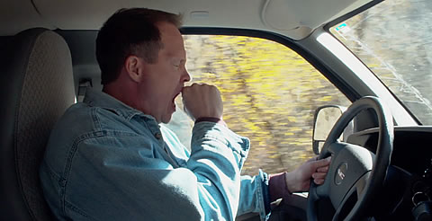
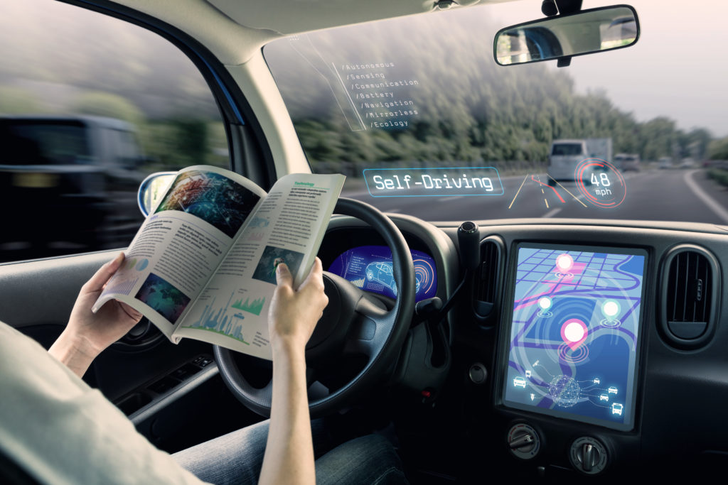
Introduction
Why Automation?

Slide 5
Objective
The objective behind developing this project is:
To have a driverless car.
To provide user convenience.
To make service available 24*7.

Slide 6
Literature Review
Paper Title: Real-Time Self-Driving Car Navigation Using Deep Neural Network
Authors:Truong-Dong Do, Minh-Thien Duong
Publication details: International Conference on Green Technology and Sustainable Development (GTSD), 2018
Findings: In this paper, they have presented an autonomous car platform based on the softmax function squashes the outputs of each unit to be between 0 and 1, just like a sigmoid function.[1]
Advantages: The system uses only one single camera for all inputs and it drives at about 5-6 km/hr whether the lane markings are present or no.
Disadvantages:This model only detects lane markings and turn signs. It just hovers the car left or right and does not sense signals or stop sign.

Slide 7
Literature Review
Paper Title: Neural controller of autonomous driving mobile robot by an embedded camera
Authors:Hajer Omrane, Mohamed Slim Masmoudi and Mohamed Masmoudi
Publication details: International Conference on Advanced Technologies For Signal and Image Processing - ATSIP, 2018
Findings: They have build an autonomous RC Car that uses Artificial Neural Network (ANN) for control. It describes the theory behind the neural network and autonomous vehicles[2]
Advantages: Using an embedded pi camera for input and gray scale of images for training in neural network.[4]
Disadvantages:The system detects lane markings for each direction and does not offer any other functionality other than that.

Slide 8
Literature Review
Paper Title: Driverless Car: Autonomous Driving Using Deep Reinforcement Learning In Urban Environment
Authors:Abdur R. Fayjie, Sabir Hossain, Doukhi Oualid, and Deok-Jin Lee
Publication details:15th International Conference on Ubiquitous Robots (UR) Hawaii Convention Center, Hawai'i, USA, June 27-30, 2018
Findings: In this paper, they have presented a reinforcement-learning based approach with Deep Q Network implemented in autonomous driving.[3]
Advantages: Using fusion of camera and lidar helps in better knowing of the surroundings and all kinds of obstacles.
Disadvantages:They have implemented a model using lidar(laser sensor) which is a very costly sensor and it is applicable for large scale cars.

Slide 9
Problem Definition
Problem Detected | Solution
Existing cars needs effort to be driven and certain amount of time goes in reaching one destination which could be utilised in some other work. | The existing human driven cars to be replaced by effective self driven cars keeping in mind of various safety conditions. So developing a model scaled car which can be implemented using monocular vision method and technology in an actual car. Implementing machine learning and image processing to gain better knowledge of new technologies. We are creating a prototype to explain the concepts of machine learning which will be helpful to teach the students as it can be presented as the live example of machine learning.

Slide 10
Existing System
Human driven cars use technologies to provide safety and detect obstacles and auto stop in various high end cars but none of them works completely driverless.
The existing cars does not contain the feature of automation to the extent that car can drive autonomously.
There is constant need of drivers without it the car becomes unavailable but with self driving car we can make the availability of car constant on roads.
In traditional cars the driver constantly needs to keep check on the signals, road safety signs, obstacles and lane and needs to make decisions accordingly.

Slide 11
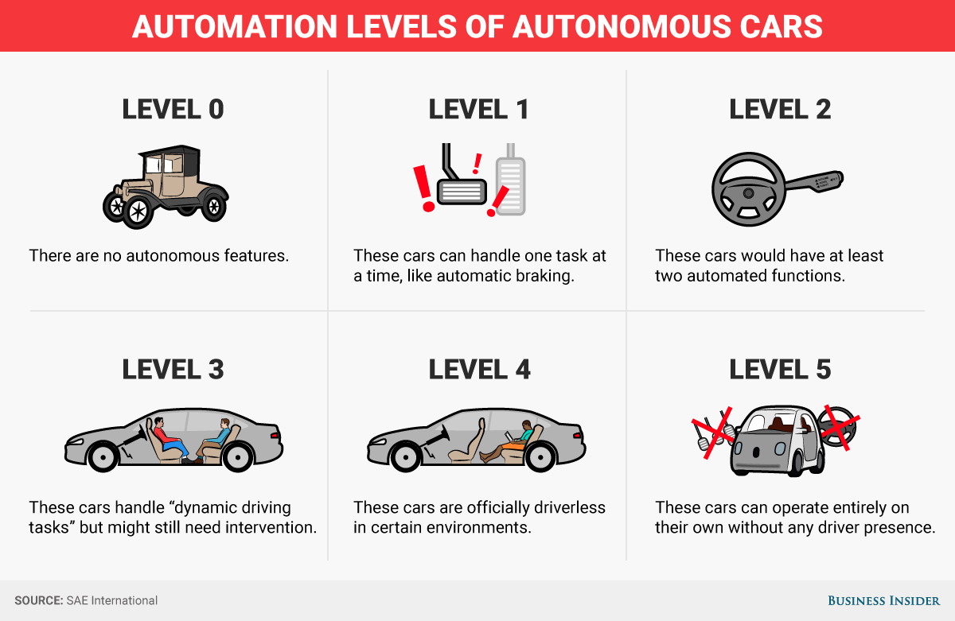

Slide 12
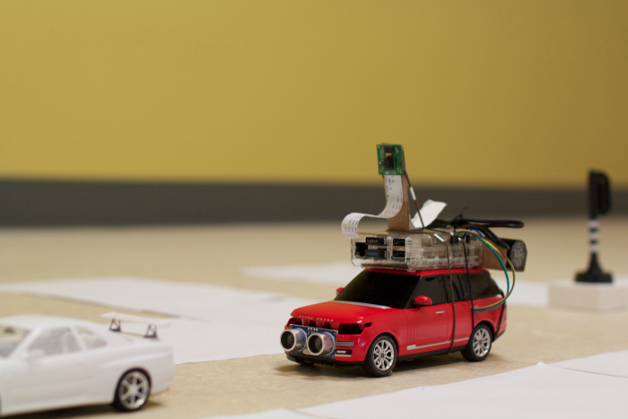
Proposed System
This project builds a self-driving RC car using Raspberry Pi, Arduino and open source software.
Raspberry Pi collects inputs from a camera module and an ultrasonic sensor, and sends data to a computer wirelessly.
The computer processes input images and sensor data for object detection (stop sign and traffic light) and collision avoidance
respectively.
A neural network model runs on
computer and makes predictions
for steering based on input
images. Predictions are then
sent to the Arduino for RC car
control.
The system uses sensor and
camera constantly to check for
obstacles and safety signs.

Slide 13
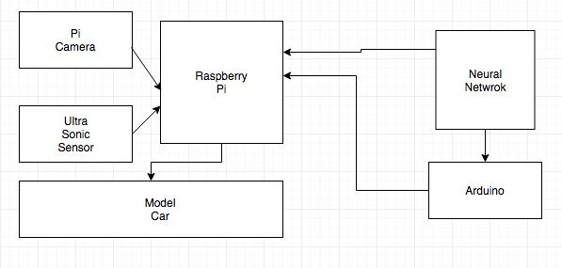
Flow Diagram

Slide 14
Technology Stack
Raspberry Pi 3
Arduino Nano
OpenCV
Ultrasonic sensor
Pi camera

Slide 15
Scope
Our car will be able to provide automation between level 4 and 5.
Car will be able to detect lane markings, obstacles, traffic signals, stop signs and take decisions accordingly.
To traverse on any road not visited before.
To work in a model environment.

Slide 16
Limitation
The car will not work automatically if there is no internet connection.
When there are no lane markings on the road the pi camera will not be able to detect the boundary within which the car should move.
Trusting a computer to perform adequately.
Sensors fail during following conditions : Drastic weather conditions, Human traffic signals and Roadblocks and local traffic laws.

Slide 17
Conclusion
With this project we are proposing a system that will allow automation of car with the help of machine learning and allows complete driverless controls and decisions made autonomously.

Slide 18
References
[1]Truong-Dong Do, Minh-Thien Duong, Quoc-Vu Dang and My-Ha Le, “Real-Time Self-Driving Car Navigation Using Deep Neural Network” in International Conference on Green Technology and Sustainable Development (GTSD), 2018
[2]Hajer Omrane, Mohamed Slim Masmoudi and Mohamed Masmoudi, “Neural controller of autonomous driving mobile robot by an embedded camera” in International Conference on Advanced Technologies For Signal and Image Processing - ATSIP, 2018
[3]Abdur R. Fayjie, Sabir Hossain, Doukhi Oualid, and Deok-Jin Lee, “Driverless Car: Autonomous Driving Using Deep Reinforcement Learning In Urban Environment” in 15th International Conference on Ubiquitous Robots (UR) Hawaii Convention Center, Hawai'i, USA, June 27-30, 2018
[4]F. Shumaila Mateenuddin, Mrs. V.S. Jahagirdar, "An Android
Controlled Mini Rover for real time surveillance using Raspberry Pi 3", in
International Journal Of Advanced Research in Engineering &
Management (IJAREM), 2017.

Slide 19
Thank You

